Slide 1

Innopolis University
Control Theory (Linear Control)
Lecture 1
Introduction
Sergei Savin, PhD
Slides design by Marko Pezer & Artem Bakhanov

Slide 2
Topic of the Lecture
Instructors
Grading
Introduction to Control
Single Input Single Output (SISO) Systems
Block Diagrams
From Linear DE to State Space Models
Control Theory (Linear Control)
Slide 2

Slide 3
Instructors
Lecture Instructor:
Sergei Savin
Tutorial Instructor:
Sergei Savin
Labs Instructors:
Shamil Mamedov
Mike Ivanov
Oleg Balakhnov
Control Theory (Linear Control)
Slide 3

Slide 4
Grading
Item | Percentage
Lab Quizzes | 10% (5x2%)
Homework | 50% (5x10%)
Mid-term Exam | 16%
Final Exam | 20%
Bonus Points | 4% (can be more)
Letter Grade | Percentage
A | 85-100
B | 70-84
C | 50-69
D | 0-49
Control Theory (Linear Control)
Slide 4

Slide 5
Process, System & Disturbance
A process is any operation to be controlled. It can be chemical, biological, economical…
A system is a combination of components that act together and perform a certain objective.
A disturbance is a signal that adversely affects the value of the output of a system. It can be internal or external.
Control Theory (Linear Control)
Slide 5

Slide 6
Control & Control System
What is Control?
What is Control System?
Control is a science.
Control is an engineering field.
Control is a process.
Control System is an object.
Control system can be a model, a program, a circuit, or an electro-mechanical system.
Control Theory (Linear Control)

Slide 7
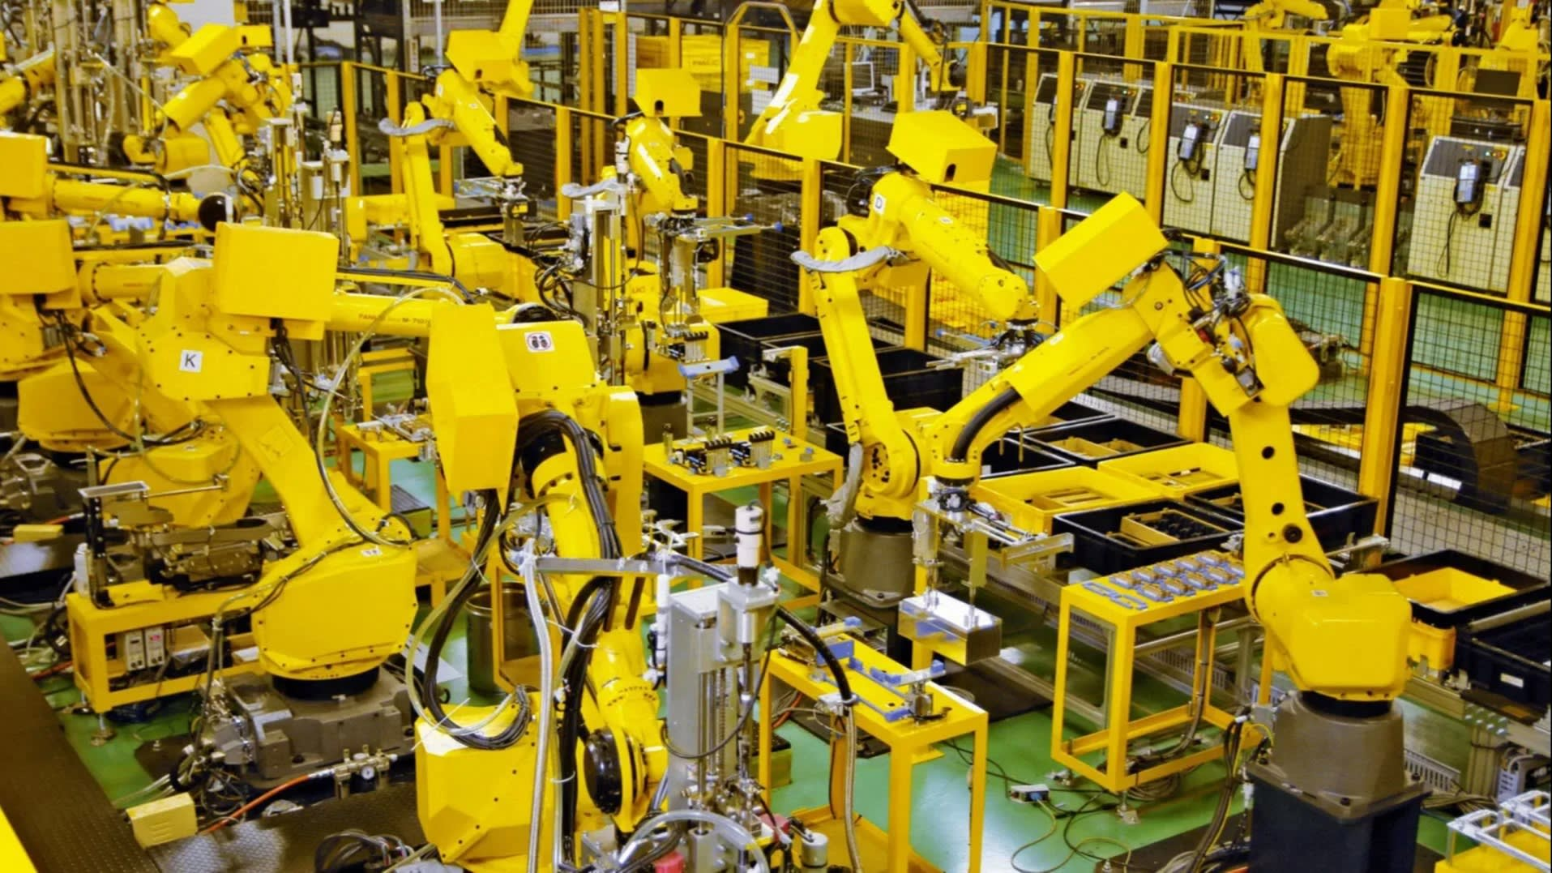
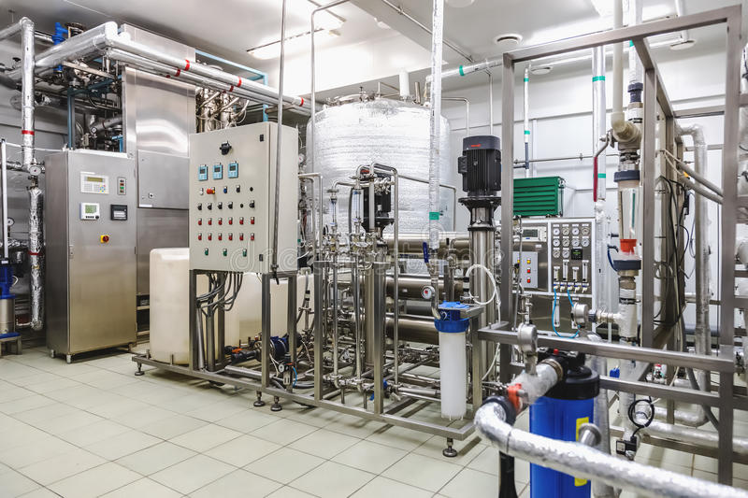

Control System Examples
Industrial arms
Chemical plants
Self-driving cars
Control Theory (Linear Control)
Slide 7

Slide 8
Single-Input Single-Output (SISO) Systems
Single-Input Single-Output (SISO) System is a simple single variable control system with one input and one output.
Examples of SISO systems:
Fan speed control
Air conditioner temperature control
Control Theory (Linear Control)
Slide 8

Slide 9
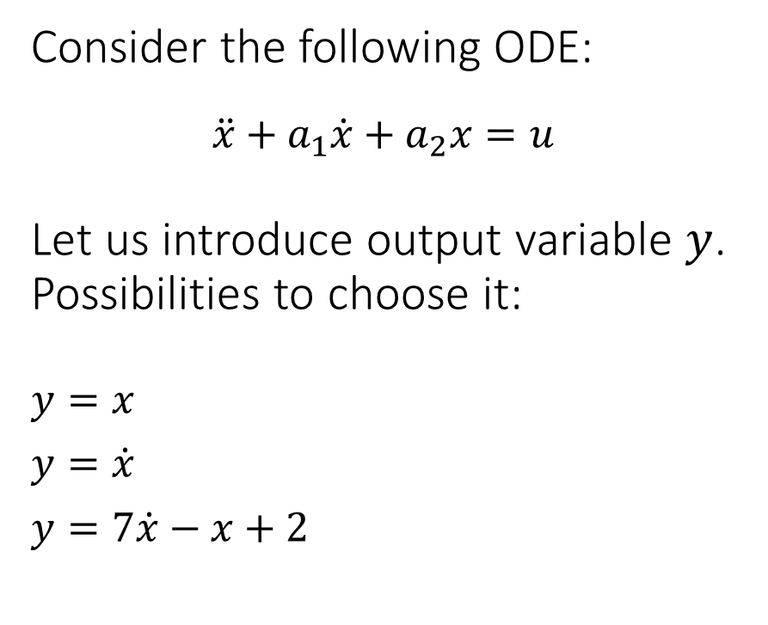
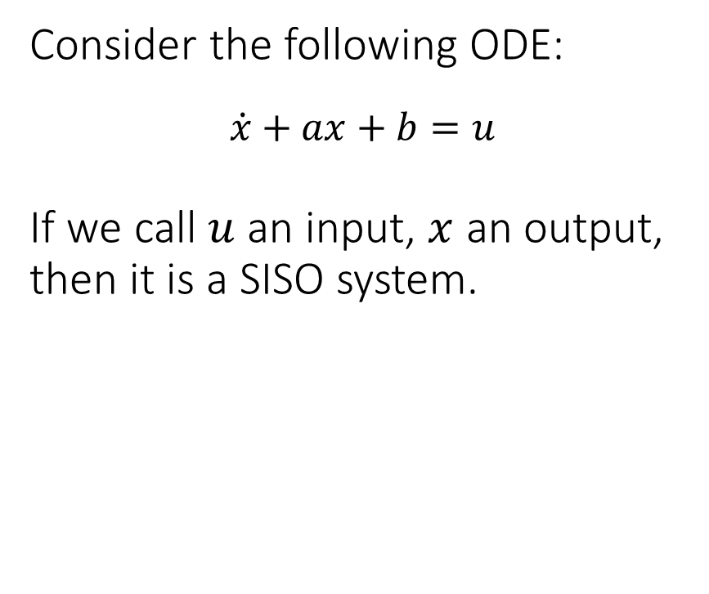
Single-Input Single-Output (SISO) Systems
Consider the following ODE:
$$\dot{x}+ax+b=u$$
If we call $u$ an input, $x$ an output, then it is a SISO system.
Consider the following ODE:
$$\ddot{x}+a_{1}\dot{x}+a_{2}x=u$$
Let us introduce output variable $y$. Possibilities to choose it:
$y=x$
$y=\dot{x}$
$y=7\dot{x}−x+2$
Control Theory (Linear Control)

Slide 10
Open-Loop System vs. Closed-Loop System
Open-Loop System
Closed-Loop System
no feedback
difficult to control output with accuracy
most of automates has open loop principle
must have feedback
must have sensor on output
almost always negative
Control Theory (Linear Control)

Slide 11
SISO Systems in Block Diagrams
Input
Controller
Controlled
Process
Output
Open Loop System
Control Theory (Linear Control)
Slide 11

Slide 12
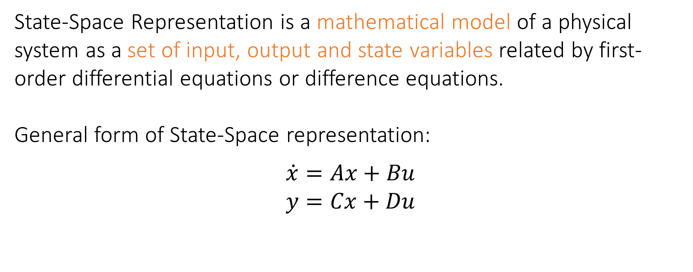
State-Space Models
State-Space Representation is a mathematical model of a physical system as a set of input, output and state variables related by first-order differential equations or difference equations.
General form of State-Space representation:
$$\dot{x}=Ax+Bu$$
$$y=Cx+Du$$
Control Theory (Linear Control)
Slide 12

Slide 13

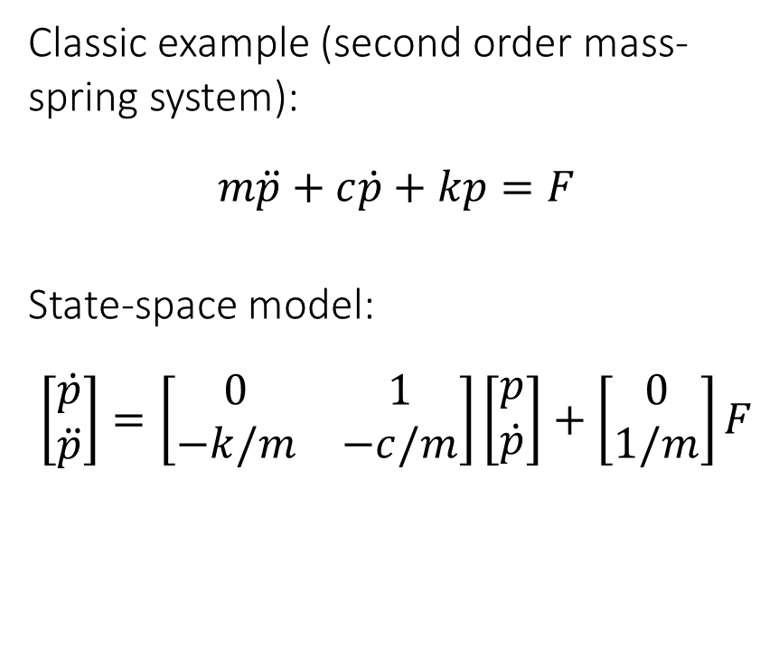
Single-Input Single-Output (SISO) Systems
Classic example (second order mass-spring system):
$$m\ddot{p}+c\dot{p}+kp=F$$
State-space model:
$$\left[\begin{matrix}\dot{p} \\ \ddot{p}\end{matrix}\right]=\left[\begin{matrix}0 & 1 \\ −k/m & −c/m\end{matrix}\right]\left[\begin{matrix}p \\ \dot{p}\end{matrix}\right]+\left[\begin{matrix}0 \\ 1/m\end{matrix}\right]F$$
Let us set:
$x_{1}=p$
$x_{2}=\dot{p}={\dot{x}}_{1}$
${\dot{x}}_{2}=\ddot{p}=(F−c\dot{p}−kp)/m=(F−cx_{2}−kx_{1})/m$
$u=F$
Now we will have:
$$x=\left[\begin{matrix}x_{1} \\ x_{2}\end{matrix}\right]=\left[\begin{matrix}p \\ \dot{p}\end{matrix}\right] ⇒ \dot{x}=Ax+Bu$$
Control Theory (Linear Control)

Slide 14
Additional Materials about State-Space Models
From ODE to State Space
Who wants to learn more?
https://www.youtube.com/watch?v=HGFZ_fl3C0c
https://www.youtube.com/playlist?list=PLn8PRpmsu08podBgFw66-IavqU2SqPg_w
Control Theory (Linear Control)

Slide 15
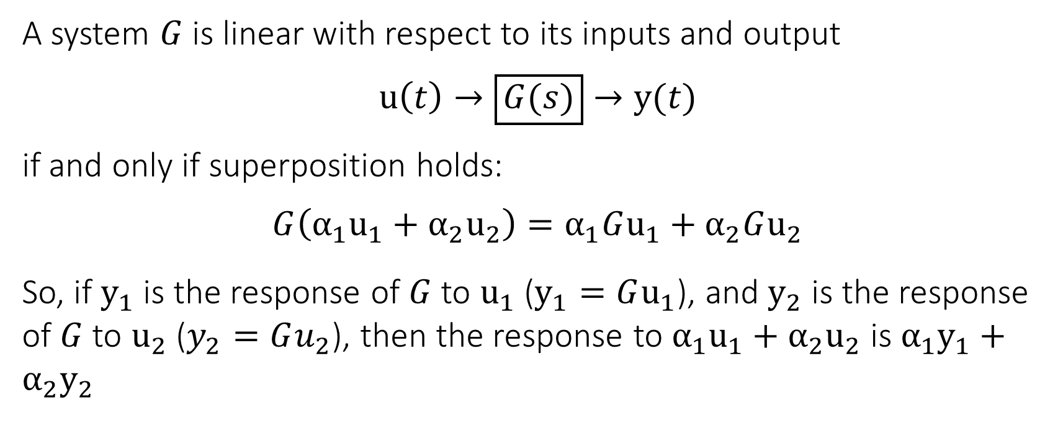
Linearity
A system $G$ is linear with respect to its inputs and output
$$u\left(t\right)→\boxed{G(s)}→y(t)$$
if and only if superposition holds:
$$G\left(α_{1}u_{1}+α_{2}u_{2}\right)=α_{1}Gu_{1}+α_{2}Gu_{2}$$
So, if $y_{1}$ is the response of $G$ to $u_{1}$ ($y_{1}=Gu_{1}$), and $y_{2}$ is the response of $G$ to $u_{2}$ ($y_{2}=Gu_{2}$), then the response to $α_{1}u_{1}+α_{2}u_{2}$ is $α_{1}y_{1}+α_{2}y_{2}$
Control Theory (Linear Control)
Slide 15

Slide 16
The End
Do you have any questions?

